Slide 1
Case Study Analysis
By: Jonathan Ponce and Hekim Aslan

Slide 2
Table of Contents
Introduction
AI Technology Description
Implementation of AI in the Financial
Benefits of AI in fraud detection
Execute transactions and analyze data
Real-time fraud detection and reducing financial loss
Enhanced decision making
Challenges and limitations
Algorithmic Biases
Privacy Concerns
Conclusion

Slide 3
Introduction
AI technology has been introduced in the financial industry. With this, it has seen a transformation that altered how business handles risks, completes transactions, and interact with clients. These financial institutions deploy sophisticated machine learning models to detect fraudulent transactions in real time, which revolutionizes AI in fraud detection and prevention.

Slide 4

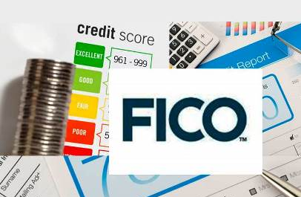
AI Technology Description
The main areas of AI in finance include robotic press automation (RPA), machine learning, and natural language processing (NLP). The way this works is that it machine learning algorithms analyze large groups of datasets in fraud detection to find trends or abnormalities that can point to fraudulent activity. An example of these AI solutions includes FICO's Falcon Fraud Manager.

Slide 5
Implementation of AI in the Financial
AI is being used in finance for other reasons other than fraud detection, such as algorithmic trading, credit assessment, and automated customer support. AI is being used by big financial companies like JPMorgan Chase and American Express to improve trading tactics through predictive analytics and use chatbots for customer service. The AI is taught to detect transaction patterns in fraud detection, allowing early identification and early stoppage of the fraudulent activity.

Slide 6
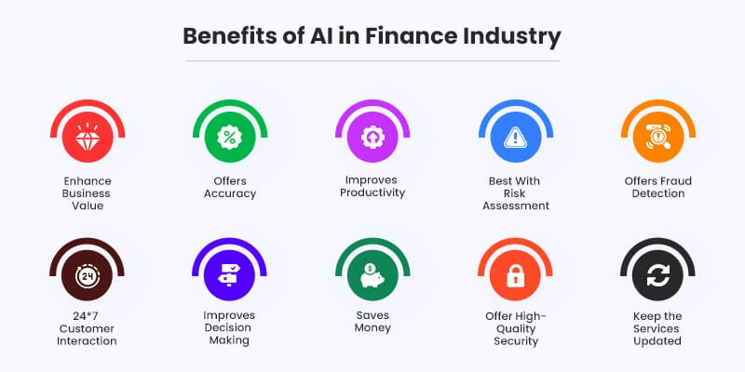
Benefits of AI in Finance
The financial industry gains several advantages from incorporation of AI technology. It cuts down on the time and expense involved with manual operations when executing transactions and analyzing data more effectively. AI also improves security with real-time detection, being able to spot the fraudulent activity quickly and prevent it before anything majorly bad happens. It reduces financial loss and is able to protect consumer data as well. It also helps with customer interactions, customizing their experience and making it personal for them.

Slide 7
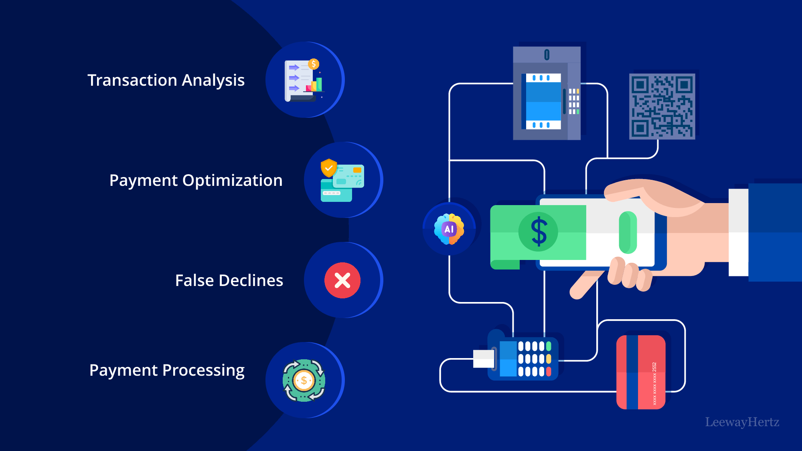
Benefits: Execute Transactions and Analyze Data
The benefit of analyzing data more effectively and executing transactions is that it can do it accurately, making it to where it has less errors. Doing these things with a human could have errors in them, but with an AI trained to recognize these patterns and errors, it would be able to provide a solution that has little to no errors, effectively saving them lots of money and time. "This automation also reduces the risk of human error and enhances the speed of the transaction."

Slide 8

Benefits: Real-Time Fraud Detection/Reducing financial loss
Another benefit is that AI has real-time detection, which allows the AI to detect the fraudulent activity ahead of time before there is any major damage done. "AI systems can monitor transactions in real-time, flagging any activity that deviates from a customer’s typical behavior. This enables banks to quickly investigate and stop potential fraud, minimizing losses." The way this is done is that the AI uses machine learning algorithms to learn patterns that everyone has, and when there's a new pattern that doesn't go with the regular AI's data, it flags it as fraudulent activity.

Slide 9
Benefits: Enhanced Decision Making
AI is able to make decisions that help both the customer and the financial service itself. The AI is able to use the data presented to it to make decisions that can most likely benefit both parties. "AI-powered algorithms can execute trades, with the predictive account information, ensuring the beneficiary receives the most appropriate currency based on available information. This automation also reduces the risk of human error and enhances the speed of the transaction."

Slide 10
Challenges and Limitations
Even with its advantages, there are drawbacks to using AI in finance. Algorithmic biases pose a serious threat as they have the potential to provide unfair results in areas like loan approvals and credit scores. AI models' "black box" nature also raises questions about transparency since it makes it hard for stakeholders to comprehend the decision-making process. Additionally, using big datasets to train AI models raises privacy concerns, particularly when managing private client data. For financial institutions to preserve public trust, these issues must be resolved by putting strong ethical standards into place and making sure that regulations are followed.

Slide 11

Challenges: Algorithmic Biases
Algorithmic Biases is a major problem when it comes to machine learning. The way this happens is when the AI's results lean towards a side more than others, for example if the data was favoring the banks and not the clients. The false data can also hurt clients, like how it might with providing loans. "Indeed, Angle Bush, founder of Black Women in Artificial Intelligence, an organization aiming to empower Black women in the AI sector, tells CNBC that when AI systems are specifically used for loan approval decisions, she has found that there is a risk of replicating existing biases present in historical data used to train the algorithms."

Slide 12
Challenges: Privacy Concern
The major problem. Privacy. People are afraid that their privacy will be sold to other companies and its happened before, where companies will sell the users information to other companies. But what scares them is how that information is used. "Financial institutions collect sensitive personal information that, if mishandled or breached, could lead to severe consequences for consumers, including identity theft and financial fraud."

Slide 13
Conclusion
Finance might transform thanks to the application of AI, which would improve consumer satisfaction, security, and efficiency. But implementing AI also presents moral conundrums, including biases in decision-making and worries about data privacy. Adopting transparent AI techniques, encouraging equity, and guaranteeing regulatory compliance are all necessary for financial organizations to overcome these obstacles. Future use of these technologies will improve, and overall be more effective than it is today.

Slide 14
Sources
FICO granted eleven new patents in fraud, AI/ML, and digital decisioning. BIIAcom Business Information Industry Association. (2022, September 26). https://www.biia.com/fico-granted-eleven-new-patents-in-fraud-ai-ml-and-digital-decisioning/ (Slide 4 image)
Matellio. (2023, December 18). Top benefits of AI in finance - matellio. Matellio Inc. https://www.matellio.com/blog/benefits-of-ai-in-finance/ (Slide 6 image and some information)
Halpin, T., & North American Head of Global Payments Solutions HSBC. (n.d.). AI in banking: Enhancing FX transactions and fraud prevention: HSBC US. AI in Banking: Enhancing FX Transactions and Fraud Prevention | HSBC US. https://www.business.us.hsbc.com/en/insights/innovation-and-transformation/harnessing-ai-to-transform-banking#:~:text=Market%20Analysis%20and%20Forecasting%3A%20AI,the%20bank%20and%20its%20clients (Slide 7-9 information)

Slide 15
Sources
Takyar, A. (2024, November 7). Ai in payment: Applications, advantages and considerations. LeewayHertz. https://www.leewayhertz.com/ai-in-payment/ (Slide 7 image)
Bhati, M. (2024, October 6). Real-time fraud detection for Seamless Digital Protection: Nected Blogs. Real-Time Fraud Detection for Seamless Digital Protection | Nected Blogs. https://www.nected.ai/blog/real-time-fraud-detection (Slide 8 image)
Ryan Browne, M. S. (2023, June 23). A.I. has a discrimination problem. in banking, the consequences can be severe. CNBC. https://www.cnbc.com/2023/06/23/ai-has-a-discrimination-problem-in-banking-that-can-be-devastating.html (Slide 11 info and image)
Editorial, P. (2024, June 7). Navigating AI in Finance. https://www.pinionglobal.com/navigating-the-future-of-ai-in-finance/#:~:text=Privacy%20Concerns%20in%20the%20Age%20of%20AI&text=Financial%20institutions%20collect%20sensitive%20personal,identity%20theft%20and%20financial%20fraud. (Slide 12)

Slide 16
Sources
“Artificial Intelligence and Fraud Detection.” https://link.springer.com/chapter/10.1007/978-3-030-75729-8_8
Eibes, Mathias, et al. “Explainable Machine Learning for Real-Time Payment Fraud Detection.” SpringerLink, Springer, 2023. https://link.springer.com/article/10.1007/s13198-023-02043-7
Zhang, Wei, et al. “Developing AI-Based Fraud Detection Systems for Banking and Finance.” IEEE Xplore, IEEE, 2023. https://ieeexplore.ieee.org/document/10220838
Luo, Xue, and James Chen. “The Application of AI and Machine Learning in the Financial Industry.” ResearchGate,2024. https://www.researchgate.net/profile/Rudra-Tiwari-

